Slide 1


Slide 2
Database Management Systems
Week 2, Day 6
MySQL—A RDBMS
Atta Muhammad
+92-333-1971110
attapanhyar@quest.edu.pk

Slide 3

RECAP
Having Clause
Inner Join
LEFT/RIGHT JOIN

Slide 4
EXISTS Operator
The EXISTS operator is used to test for the existence of any record in a subquery.
The EXISTS operator returns TRUE if the subquery returns one or more records.

Slide 5
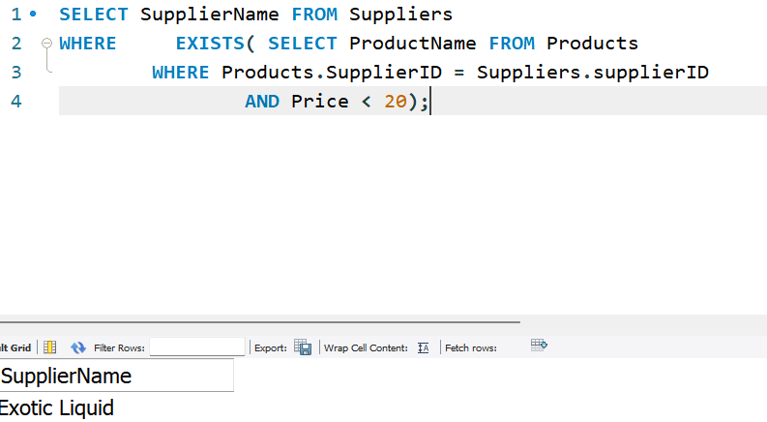
EXISTS Example

Slide 6
CASE
The CASE statement goes through conditions and returns a value when the first condition is met (like an if-then-else statement).
So, once a condition is true, it will stop reading and return the result.
If no conditions are true, it returns the value in the ELSE clause.

Slide 7
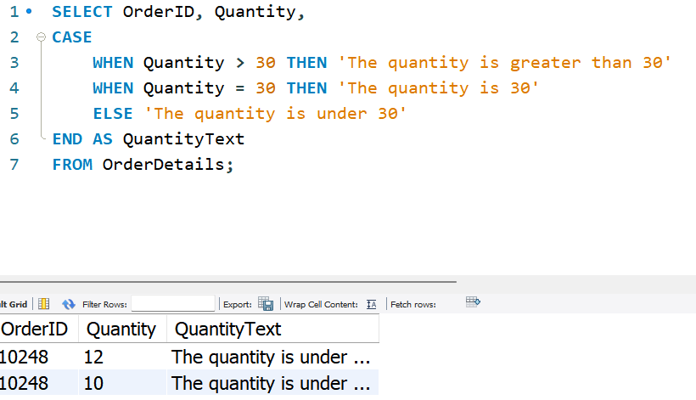
CASE –Example

Slide 8
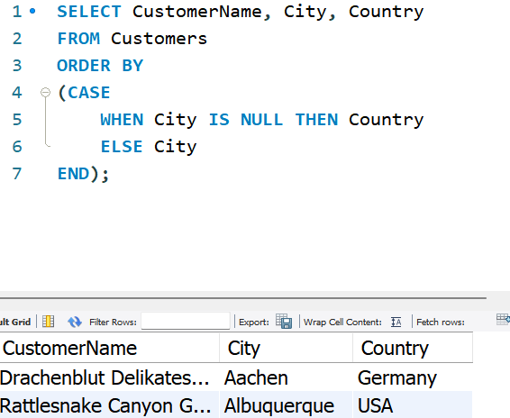
CASE –Example

Slide 9

Create a Database
The CREATE DATABASE statement is used to create a new SQL database.

Slide 10
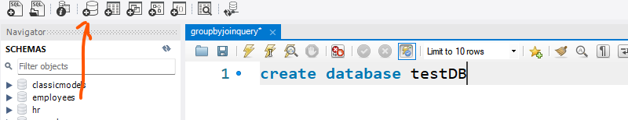
CREATE a DATABASE

Slide 11
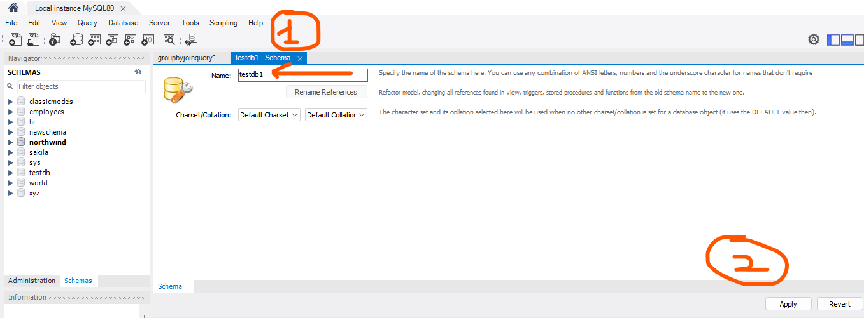
CREATE a DATABASE

Slide 12
CREATE a DATABASE

Slide 13
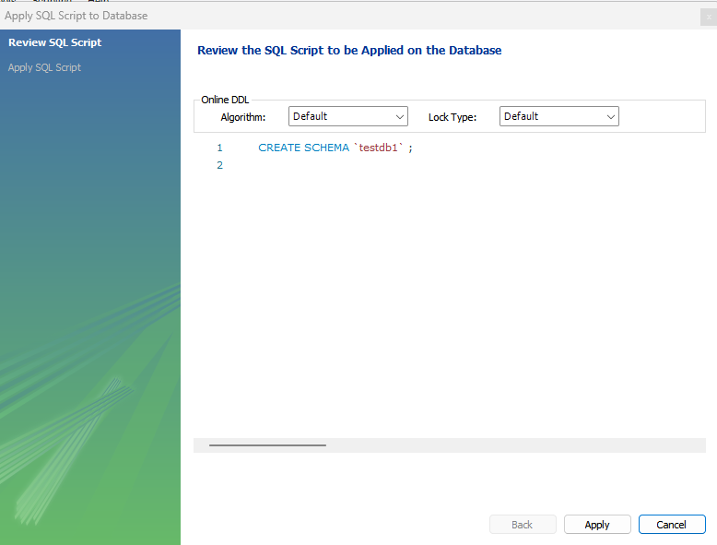

Slide 14
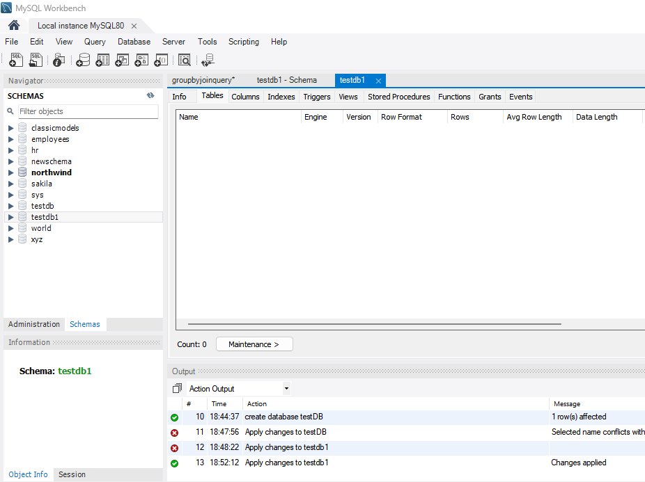

Slide 15
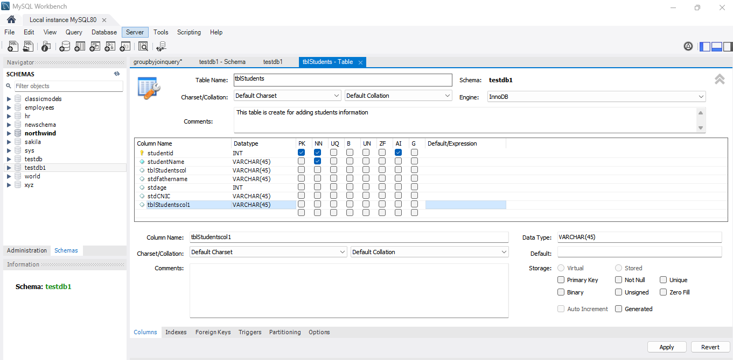

Slide 16
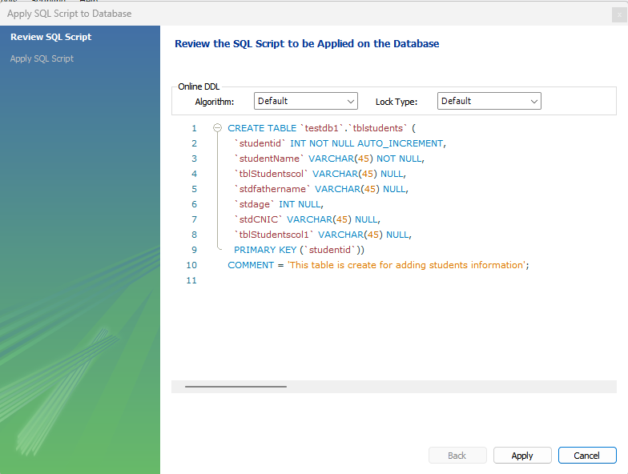

Slide 17
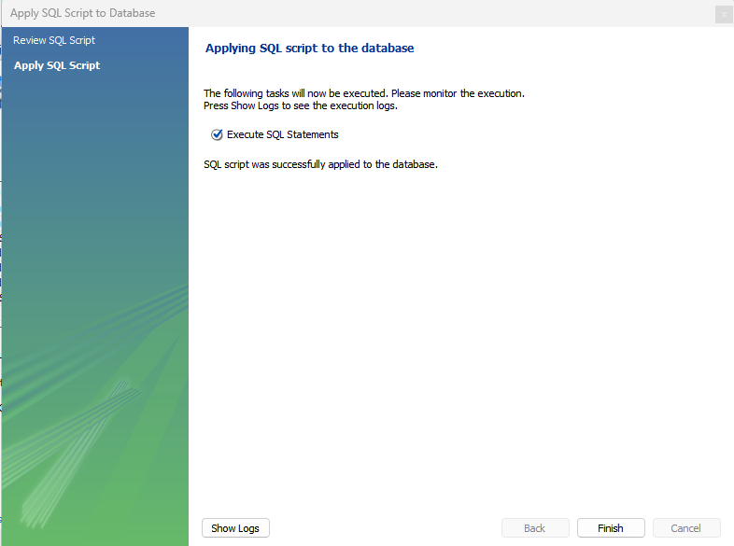

Slide 18

DROP DATABASE Statement

Slide 19
ALTER TABLE Statement
The ALTER TABLE statement is used to add, delete, or modify columns in an existing table.
The ALTER TABLE statement is also used to add and drop various constraints on an existing table

Slide 20
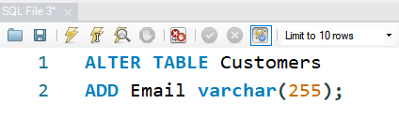
ALTER TABLE –Example

Slide 21
ALTER TABLE - DROP COLUMN
To delete a column in a table, use the following syntax (notice that some database systems don't allow deleting a column):

Slide 22
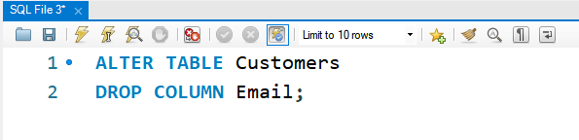
ALTER TABLE –DROP COLUMN

Slide 23
ALTER TABLE - MODIFY COLUMN
To change the data type of a column in a table, use the following syntax

Slide 24
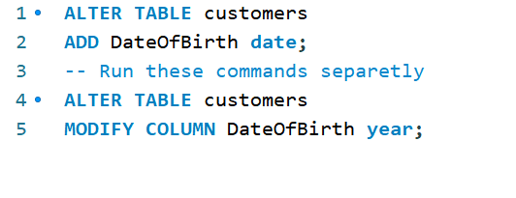
MODIFY

Slide 25
Constraints
SQL constraints are used to specify rules for data in a table.
Constraints can be specified when the table is created with the CREATE TABLE statement, or after the table is created with the ALTER TABLE statement.

Slide 26
Constraints
Constraints are used to limit the type of data that can go into a table.
This ensures the accuracy and reliability of the data in the table.
If there is any violation between the constraint and the data action, the action is aborted.

Slide 27
Constraints
Constraints can be column level or table level.
Column level constraints apply to a column, and table level constraints apply to the whole table.

Slide 28
Common Constraints
NOT NULL - Ensures that a column cannot have a NULL value
UNIQUE - Ensures that all values in a column are different
PRIMARY KEY - A combination of a NOT NULL and UNIQUE. Uniquely identifies each row in a table
FOREIGN KEY - Prevents actions that would destroy links between tables
CHECK - Ensures that the values in a column satisfies a specific condition
DEFAULT - Sets a default value for a column if no value is specified
CREATE INDEX - Used to create and retrieve data from the database very quickly

Slide 29
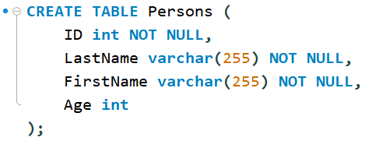
NOT NULL Constraint
By default, a column can hold NULL values.
The NOT NULL constraint enforces a column to NOT accept NULL values.

Slide 30

Constraints on ALTER TABLE

Slide 31
UNIQUE Constraint
The UNIQUE constraint ensures that all values in a column are different.
A PRIMARY KEY constraint automatically has a UNIQUE constraint.

Slide 32
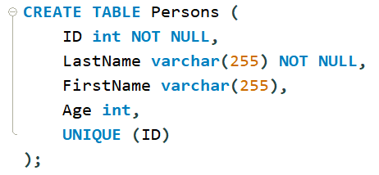
UNIQUE Constraint on CREATE TABLE

Slide 33
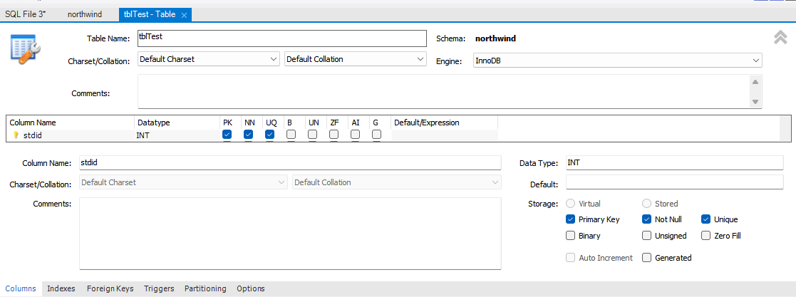
Graphically…

Slide 34
PRIMARY KEY Constraint
The PRIMARY KEY constraint uniquely identifies each record in a table.
Primary keys must contain UNIQUE values and cannot contain NULL values.
A table can have only ONE primary key; and in the table, this primary key can consist of single or multiple columns (fields)

Slide 35
FOREIGN KEY Constraint
The FOREIGN KEY constraint is used to prevent actions that would destroy links between tables.
A FOREIGN KEY is a field (or collection of fields) in one table, that refers to the PRIMARY KEY in another table.

Slide 36
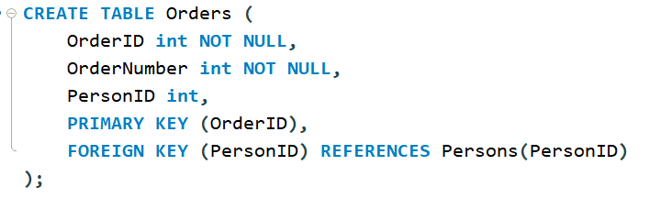
FOREIGN KEY

Slide 37
Question(s)

